Slide 1

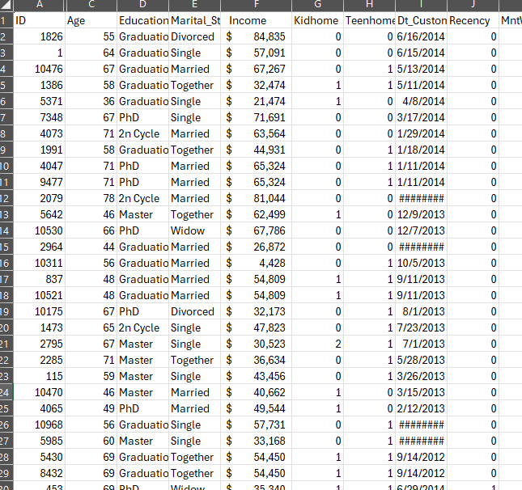






Introduction
Dataset:
Marketing campaign data (Source: Maven Marketing)
2,240 customers
Goal:
To provide recommendations on
Grow digital revenue
Boost online conversions
Analysis focus:
Key customer group(s)
Channel performance
Product categories

Slide 2

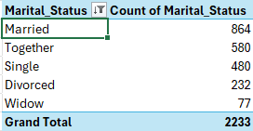
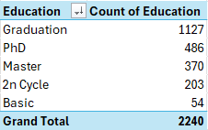
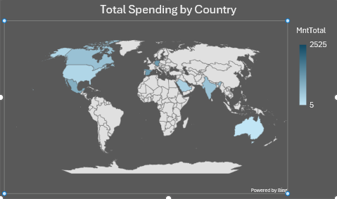
What does the average Maven customer look like?
In mid-50s
Married
Graduate
Often has children/teens at home
Top geographies: Spain, Saudi and Canada

Slide 3
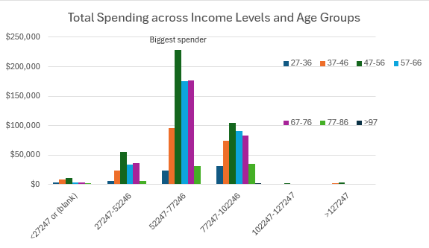
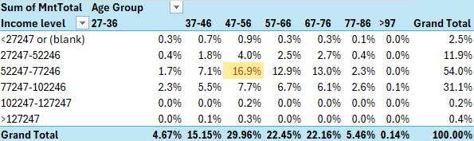
Core customer group
In fact, this single group generates 16.9% of Maven’s total revenue
This key segment
Earns income of 52-77k
Age 47-56
Prioritize marketing efforts, crucial growth driver
Fig.1 Crosstabs analysis of revenue streams

Slide 4
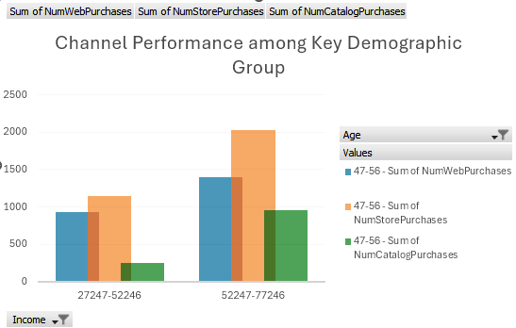
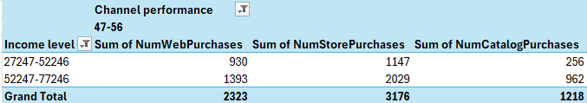
Which channels are most salient to this group?
In-store and Web purchases outperform
Next we’ll take a deep dive into web purchases in our dataset…
Fig2. PivotChart and PivotTable channel analysis

Slide 5
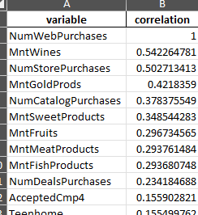
What factors are good predictors of web purchases?
Two positive correlations
Number of store purchases
Cross-channel buyers (coef ≈ +0.0420, p < 0.001)
Spend on wines
Higher wine spend is associated with more web purchases. (coefficient ≈ +0.0006, p < 0.001)
One negative correlation
Number of catalog purchases (coef ≈ −0.0155, p ≈ 0.003)
More catalog purchases are slightly associated with fewer web purchases. Suggesting the catalog channel underperforms for driving web purchases.
Fig3. Poisson regression using Python add-in

Slide 6

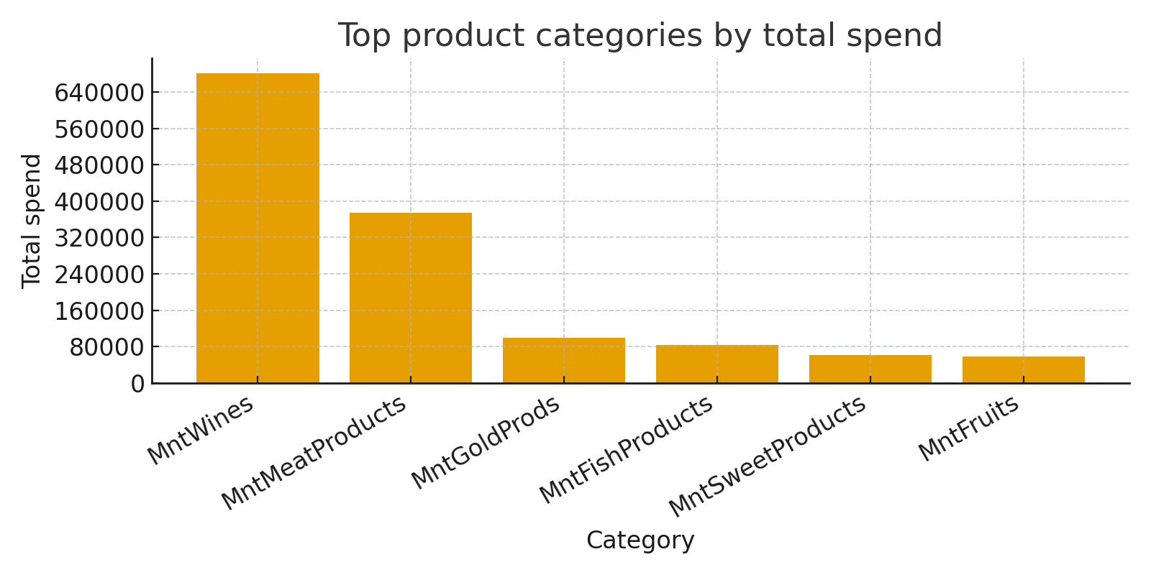
Which products are performing best?
Wine and Meat are the highest-revenue categories
Wine also strongly predicts increased web purchases, so it’s a strategic priority for web promotions and cross-sell.

Slide 7
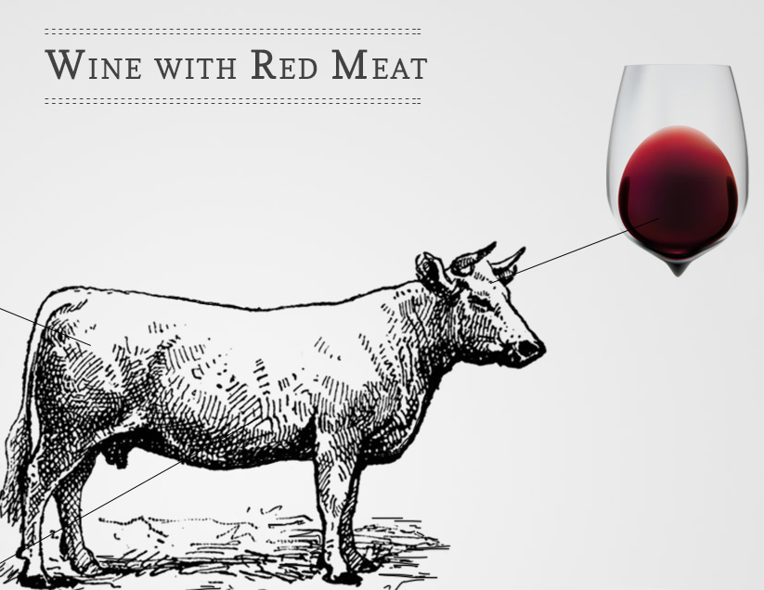

Actionable recommendations
Double down on wine-focused online promotions.
Bundle with web-only offers
Targeted emails showcasing wines
Cross-sell widgets on product pages
Rationale: 🍷 Top revenue driver, strongly predict web purchases
Cross-sell store buyers online
Using in-store receipts
Loyalty messaging
Push online offers and subscriptions
Rationale: 🛍️In-store purchases positively predicts web purchases

Slide 8



Actionable recommendations (cont.)
Re-think catalog strategy for web growth.
Incentivize catalog recipients to shop online
First-web-order discount
Convert catalog into an omni-channel touchpoint
Rationale: Catalog buyers less likely to buy online
Increase web purchases for households with children
Create family-friendly bundles
Promote convenience (subscription, larger pack sizes)
Rationale: Customers with kids buy less online
Prioritize product pages & merchandising for wines and meats.
Improve product page CTAs, related products, and web-exclusive bundles for top categories.

